Slide 1

AMAZON SALES DATA ANALYSIS

Slide 2
INTRODUCTION
Sales management has gained importance to meet increasing competition and the need for improved methods of distribution to reduce cost and to increase profits. Sales management today is the most important function in a commercial and business enterprise.
Amazon is one of the competitive e-commerce industry.Here we find the month-wise, year-wise, yearly-month-wise sales trend of the Amazon sales data.

Slide 3
Details of Data
The given data has 100 rows and 14 columns. The data gives the sales information of amazon from 2010- 2017. There is no null values and duplicated values in the data but has outliers. Outliers are cleaned using winsorization method.

Slide 4
Main KPI’s
Total Revenue (TR): total income generated from sales
Total Cost (TC): total expenses associated with producing and delivering the products.
Total Profit (TP): difference between total revenue and total cost, indicating overall profitability.
Total Units Sold (TUS): total number of products or services sold.
Order Priority (OP): distribution of orders by their priority, which can affect order processing and customer satisfaction.
Sales by Sales Channel (SbSC): Breakdown of sales by different channels (e.g., online, offline)
Sales by Item Type (SbIT): Analysis of sales by the type or category of products.
Sales by Region (SbR): Breakdown of sales by geographic region
Highest sale

Slide 5
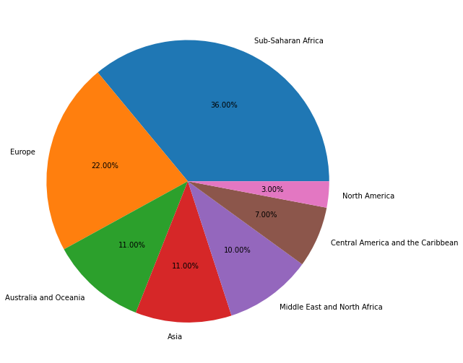
Sales per Region
Highest sale
Sub-Saharan Africa has highest and North America has lowest sales.

Slide 6
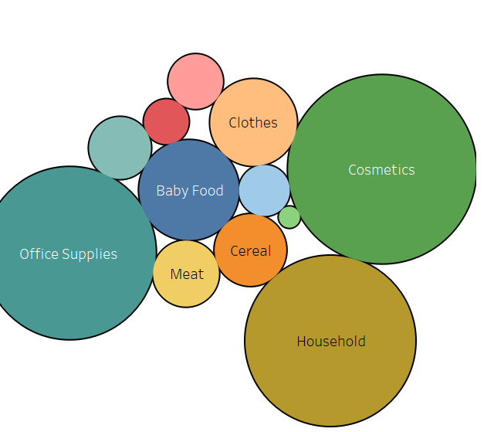
Sales per Product
Highest sale
Cosmetics have the highest sales, while fruits have the lowest sales.

Slide 7
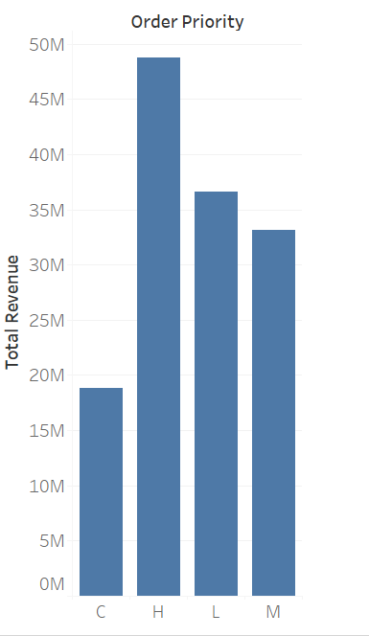
Sales per Order Priority
Highest sale
Sales priority "H," has the highest and “C” has lowest sales

Slide 8
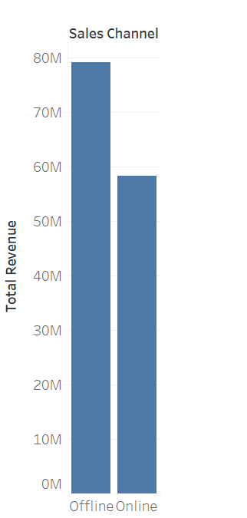
Sales per Channel
Highest sale
Sales is more in offline mode than in online mode.

Slide 9
Sales per Year
The year 2012 had the highest total sales. After 2012, sales seem to have gradually declined. The years 2013 and 2014 still had relatively high sales compared to the later years. Sales experienced a noticeable drop in 2015 in total sales. Sales continued to fluctuate in the following years but generally remained below the levels seen in 2010-2014.
Year Total Sales
2010 18114230.05
2011 11129166.07
2012 31856519.07
2013 20330448.66
2014 16307847.25
2015 11239537.76
2016 12372867.22
2017 11701147.05
Highest sales

Slide 10
Month Total Sales Jan 9294022.02 Feb 23068245.19 Mar 2274823.87 Apr 16145060.88 May 13215739.99 Jun 5230325.77 Jul 15669518.50 Aug 1128164.91 Sep 5314762.56 Oct 14215781.74 Nov 20245855.58 Dec 7249462.12
Sales per Month
Highest sale
Highest sales is in February and lowest in August

Slide 11
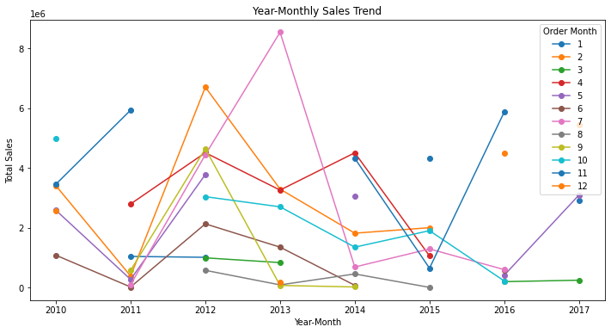
Sales in Year-monthly
Highest sale
February (2012-02) and April (2012-04) have significantly higher sales. August (2015-08) had very low sales.

Slide 12
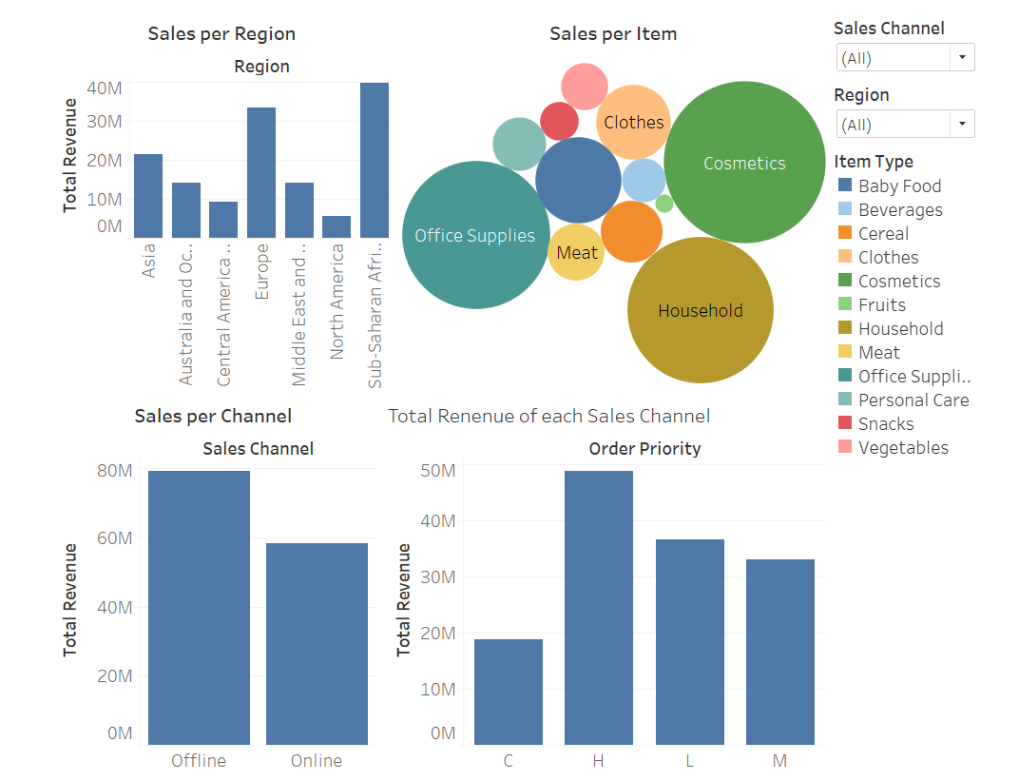
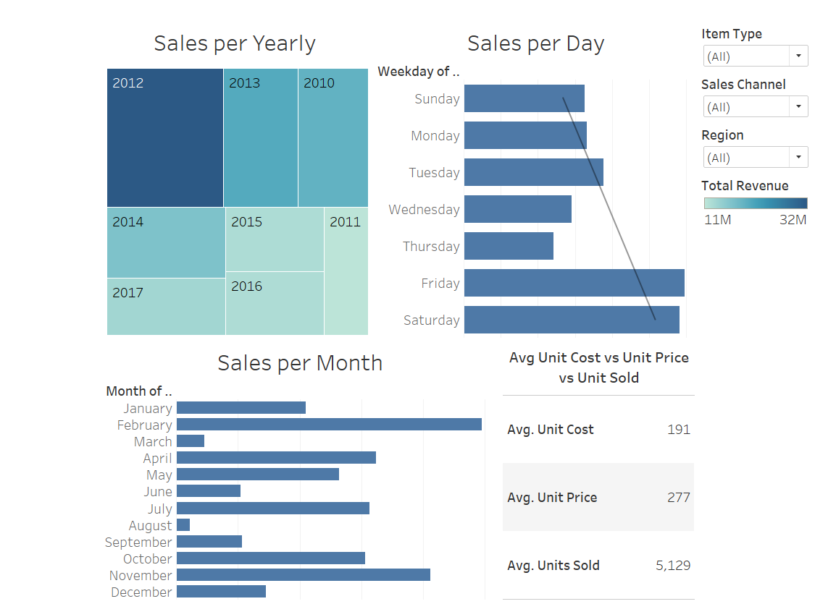
My Dashboard
Highest sale

Slide 13
THANK YOU
Highest sale

